Slide 1
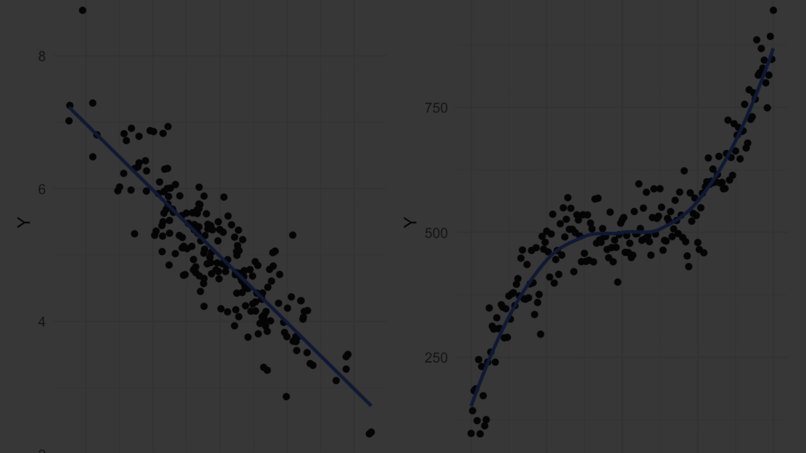
Multiple Linear Regression in R
Predicting Fuel Efficiency with the mtcars Dataset
kamal kumar

Slide 2
Introduction to Multiple Linear Regression
1
Brief Explanation
2
Purpose of Analysis
Predicting fuel efficiency based on car attributes.
Predicting fuel efficiency (mpg) using various car attributes.

Slide 3
Overview of the Dataset
1
Description
Features included: cylinders, displacement, horsepower, weight, quarter mile time, etc.

Slide 4
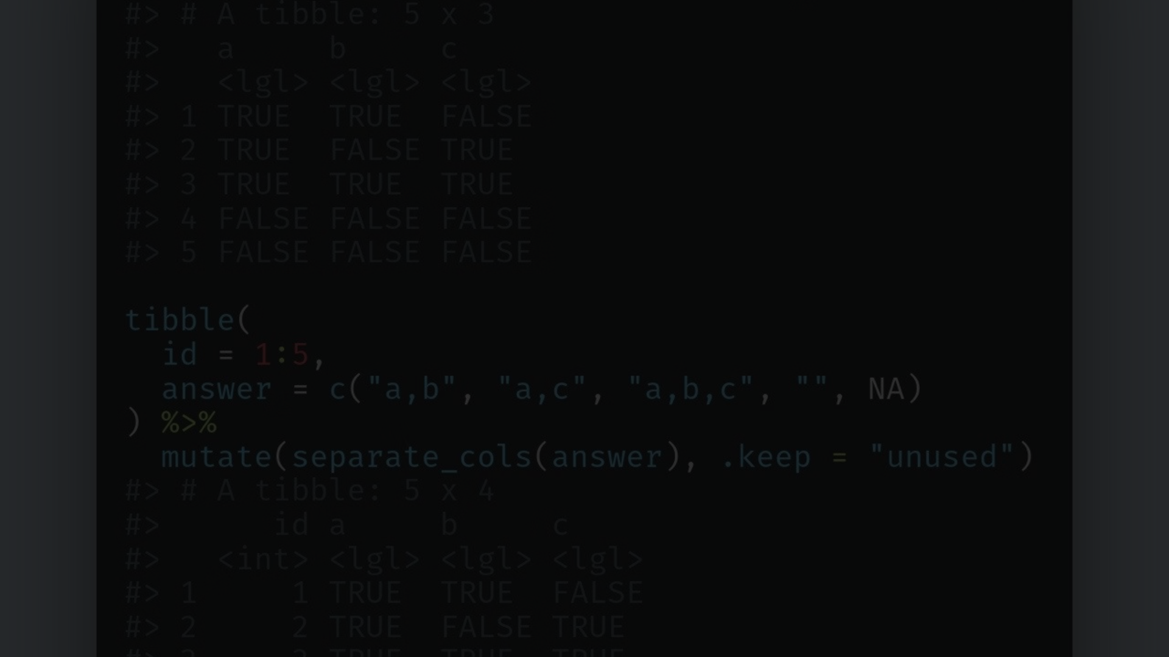
Code Implementation
Load Dataset
Perform Regression
Summary
Use data(mtcars) to load the dataset.
Use lm() function for multiple linear regression.
Summary of the regression model using summary().

Slide 5
Model Evaluation
Predicting Fuel Efficiency
RMSE Calculation
Using the regression model and visualizing the results with a scatter plot.
Calculating the Root Mean Squared Error (RMSE) as an evaluation metric.

Slide 6
Interpretation of Results
1
Coefficients Interpretation
2
Significance of Predictors
Interpretation of coefficients from the regression summary.
Discussion on the significance of predictors.

Slide 7

Conclusion
1
Summary of Findings
2
Potential Applications
Summarizing the findings from the analysis.
Discussing potential applications of the model.

Slide 8
References
1
Further Reading
Sources for additional reading or data references.

